Slide 1

TITLE DEED
MEDITERRANEAN AVENUE
RENT
With 2 Houses
With 3 Houses
With 4 Houses
$2
With 1 House
$ 10
30
90
160
With HOTEL $ 250
Mortgage Value $ 30
Houses cost $ 50 each
Hotels, $ 50 plus 4 houses

Slide 2
TITLE DEED
BALTIC AVENUE
RENT
With 2 Houses
With 3 Houses
With 4 Houses
$4
With 1 House
$ 20
60
180
320
With HOTEL $ 450
Mortgage Value $ 30
Houses cost $ 50 each
Hotels, $ 50 plus 4 houses

Slide 3
TITLE DEED
ORIENTAL AVENUE
RENT
With 2 Houses
With 3 Houses
With 4 Houses
$6
With 1 House
$ 30
90
270
400
With HOTEL $ 550
Mortgage Value $ 25
Houses cost $ 50 each
Hotels, $ 50 plus 4 houses

Slide 4
TITLE DEED
VERMONT AVENUE
RENT
With 2 Houses
With 3 Houses
With 4 Houses
$6
With 1 House
$ 30
90
270
400
With HOTEL $ 550
Mortgage Value $ 25
Houses cost $ 50 each
Hotels, $ 50 plus 4 houses

Slide 5
TITLE DEED
CONNECTICUT AVENUE
RENT
With 2 Houses
With 3 Houses
With 4 Houses
$8
With 1 House
$ 40
100
300
450
With HOTEL $ 600
Mortgage Value $ 25
Houses cost $ 50 each
Hotels, $ 50 plus 4 houses

Slide 6
TITLE DEED
ST. CHARLES PLACE
RENT
With 2 Houses
With 3 Houses
With 4 Houses
$10
With 1 House
$ 50
150
450
625
With HOTEL $ 750
Mortgage Value $70
Houses cost $ 100 each
Hotels, $ 100 plus 4 houses

Slide 7

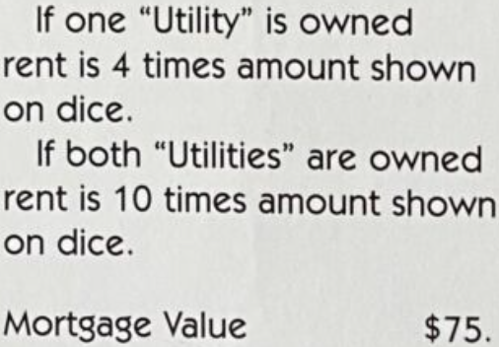
ELECTRIC COMPANY

Slide 8
TITLE DEED
STATES AVENUE
RENT
With 2 Houses
With 3 Houses
With 4 Houses
$10
With 1 House
$ 50
150
450
625
With HOTEL $ 750
Mortgage Value $70
Houses cost $ 100 each
Hotels, $ 100 plus 4 houses

Slide 9
TITLE DEED
VIRGINIA AVENUE
RENT
With 2 Houses
With 3 Houses
With 4 Houses
$12
With 1 House
$ 60
180
500
700
With HOTEL $ 900
Mortgage Value $80
Houses cost $ 100 each
Hotels, $ 100 plus 4 houses

Slide 10
TITLE DEED
ST. JAMES PLACE
RENT
With 2 Houses
With 3 Houses
With 4 Houses
$14
With 1 House
$ 70
200
550
750
With HOTEL $ 950
Mortgage Value $80
Houses cost $ 100 each
Hotels, $ 100 plus 4 houses

Slide 11
TITLE DEED
TENNESSEE AVENUE
RENT
With 2 Houses
With 3 Houses
With 4 Houses
$14
With 1 House
$ 70
200
550
750
With HOTEL $ 950
Mortgage Value $80
Houses cost $ 100 each
Hotels, $ 100 plus 4 houses

Slide 12
TITLE DEED
NEW YORK AVENUE
RENT
With 2 Houses
With 3 Houses
With 4 Houses
$16
With 1 House
$ 80
250
600
800
With HOTEL $ 1000
Mortgage Value $100
Houses cost $ 100 each
Hotels, $ 100 plus 4 houses

Slide 13
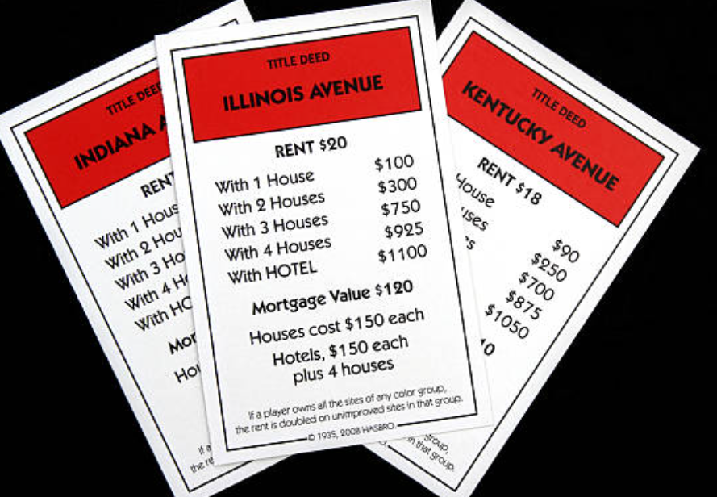
TITLE DEED
KENTUCKY AVENUE
RENT
With 2 Houses
With 3 Houses
With 4 Houses
$18
With 1 House
$ 90
250
700
875
With HOTEL $ 1050
Mortgage Value $ 110
Houses cost $ 150 each
Hotels, $ 150 plus 4 houses

Slide 14
TITLE DEED
INDIANA AVENUE
RENT
With 2 Houses
With 3 Houses
With 4 Houses
$18
With 1 House
$ 90
250
700
875
With HOTEL $ 1050
Mortgage Value $ 110
Houses cost $ 150 each
Hotels, $ 150 plus 4 houses

Slide 15
TITLE DEED
ILLINOIS AVENUE
RENT
With 2 Houses
With 3 Houses
With 4 Houses
$20
With 1 House
$ 100
300
750
925
With HOTEL $ 1100
Mortgage Value $ 120
Houses cost $ 150 each
Hotels, $ 150 plus 4 houses

Slide 16

PENNSYLVANIA RAILROAD
Rent
If 2 R.E’s are owned
If 3 “ “ “
If 4 “ “ “
$ 200
500
1100
1300
Mortgage Value 100

Slide 17
TITLE DEED
ATLANTIC AVENUE
RENT
With 2 Houses
With 3 Houses
With 4 Houses
$22
With 1 House
$ 110
330
800
975
With HOTEL $ 1150
Mortgage Value $ 130
Houses cost $ 150 each
Hotels, $ 150 plus 4 houses

Slide 18
TITLE DEED
VENTOR AVENUE
RENT
With 2 Houses
With 3 Houses
With 4 Houses
$22
With 1 House
$ 110
330
800
975
With HOTEL $ 1150
Mortgage Value $ 130
Houses cost $ 150 each
Hotels, $ 150 plus 4 houses

Slide 19
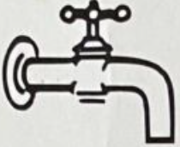
WATER WORKS

Slide 20
TITLE DEED
MARVIN GARDENS
RENT
With 2 Houses
With 3 Houses
With 4 Houses
$24
With 1 House
$ 120
360
850
1025
With HOTEL $ 1200
Mortgage Value $ 140
Houses cost $ 150 each
Hotels, $ 150 plus 4 houses

Slide 21
TITLE DEED
PACIFIC AVENUE
RENT
With 2 Houses
With 3 Houses
With 4 Houses
$26
With 1 House
$ 130
390
900
1100
With HOTEL $ 1275
Mortgage Value $ 150
Houses cost $ 200 each
Hotels, $ 200 plus 4 houses

Slide 22
TITLE DEED
NORTH CAROLINA AVENUE
RENT
With 2 Houses
With 3 Houses
With 4 Houses
$26
With 1 House
$ 130
390
900
1100
With HOTEL $ 1275
Mortgage Value $ 150
Houses cost $ 200 each
Hotels, $ 200 plus 4 houses

Slide 23
TITLE DEED
PENNSYLVANIA AVENUE
RENT
With 2 Houses
With 3 Houses
With 4 Houses
$28
With 1 House
$ 150
450
1000
1200
With HOTEL $ 1400
Mortgage Value $ 160
Houses cost $ 200 each
Hotels, $ 200 plus 4 houses

Slide 24
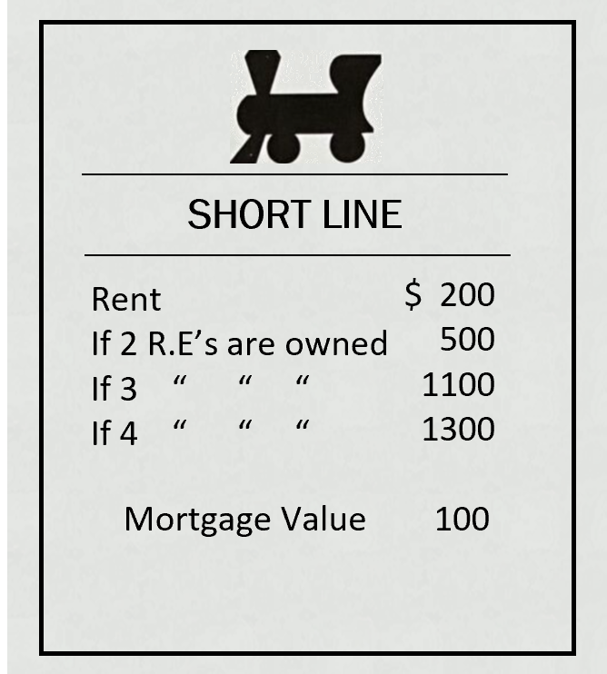

Slide 25
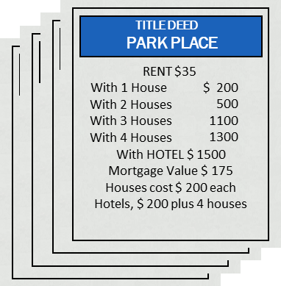

TITLE DEED
PARK PLACE
RENT
With 2 Houses
With 3 Houses
With 4 Houses
$35
With 1 House
$ 175
500
1100
1300
With HOTEL $ 1500
Mortgage Value $ 175
Houses cost $ 200 each
Hotels, $ 200 plus 4 houses

Slide 26
TITLE DEED
Boardwalk
RENT
With 2 Houses
With 3 Houses
With 4 Houses
$50
With 1 House
$ 200
600
1400
1700
With HOTEL $ 2000
Mortgage Value $ 200
Houses cost $ 200 each
Hotels, $ 200 plus 4 houses

